Slide 1
Adapting the Visualization Toolkit for Many-Core Processors with the VTK-m Library
Christopher Sewell (LANL) and Robert Maynard (Kitware)
VTK-m Team:
LANL: Christopher Sewell, Li-ta Lo
Kitware: Robert Maynard, Berk Geveci
SNL: Ken Moreland
ORNL: Jeremy Meredith, David Pugmire
University of Oregon: Hank Childs, Matthew Larsen, James Kress
UC Davis: Kwan-Liu Ma, Hendrik Schroots
University of Utah: William Usher
The Ohio State University: Chun-Ming Chen, Kewei Lu
Acknowledgement: Many of the slides in this presentation were created by the various members of the project above, especially Ken Moreland.
LA-UR16-21111

Slide 2
Outline
Overview of VTK-m
Motivation
Intended Uses
History
Applications Using VTK-m
Isosurfaces
Surface Simplification
Ray Tracing
Direct Volume Rendering
Data-Parallel Programming
Primitives
Algorithms
Introductory Tutorial
Getting, Building, and Running VTK-m
Array Handles
Data Sets
Worklets
Cells
Device Adapter Algorithms
Example cell average worklet and filter
Demo application
LA-UR16-21111

Slide 3
Overview of VTK-m
Motivation, Intended Uses, History
LA-UR16-21111

Slide 4
Extreme Scale: Threads, Threads Threads!
A clear trend in supercomputing is ever increasing parallelism
Clock increases are long gone
“The Free Lunch Is Over” (Herb Sutter)
 | Jaguar – XT5 | Titan – XK7 | Exascale*
Cores | 224,256 | 299,008 cpu and 18,688 gpu | 1 billion
Concurrency | 224,256 way | 70 – 500 million way | 10 – 100 billion way
Memory | 300 Terabytes | 700 Terabytes | 128 Petabytes
*Source: Scientific Discovery at the Exascale, Ahern, Shoshani, Ma, et al.
LA-UR16-21111

Slide 5
Performance Portability
Architecture
CPU
GPU
MIC
???
A
B
C
D
E
F
Algorithm
LA-UR16-21111

Slide 6
Performance Portability
Backend
CPU
GPU
MIC
???
VTK-m
A
B
C
D
E
F
Algorithm
LA-UR16-21111

Slide 7
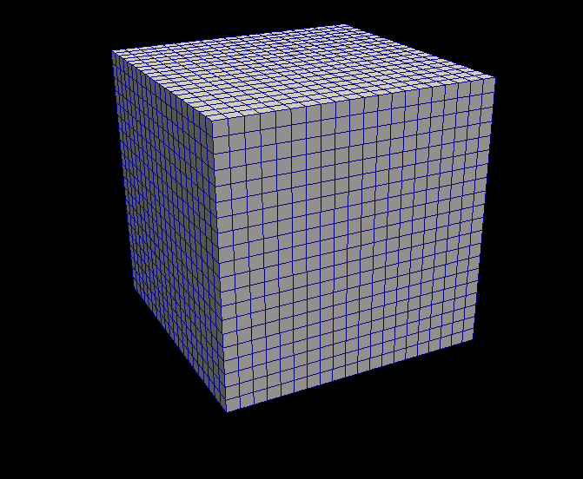
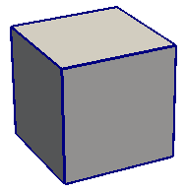
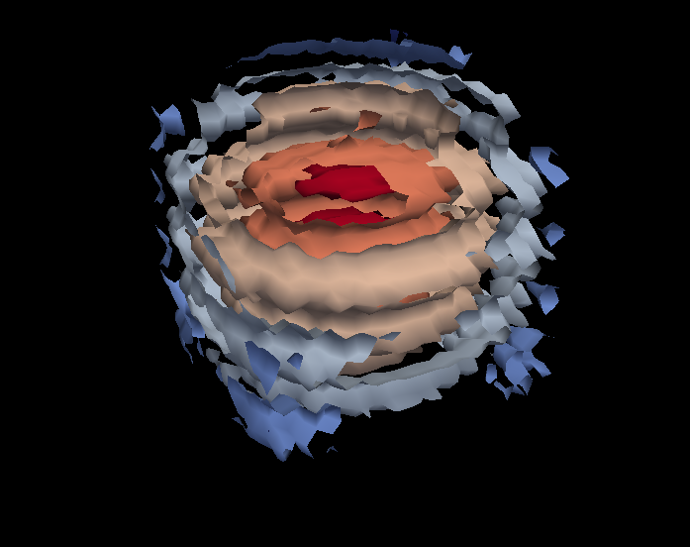
VTK-m Framework
Control Environment
Grid Topology
Array Handle
Invoke
Execution Environment
Cell Operations
Field Operations
Basic Math
Make Cells
Device Adapter
Allocate
Transfer
Schedule
Sort
…
Worklet
LA-UR16-21111

Slide 8
The Main Use Cases for VTK-m
Use
I heard VTK-m has an isosurface filter. I want to use it in my software
Develop
I want to make a new filter that computes fields in the same way as my simulation that works well on multicore devices
Research
I have a new idea for a way to do visualization on multicore devices
LA-UR16-21111

Slide 9
VTK-m Combining Dax, PISTON, EAVL
LA-UR16-21111

Slide 10
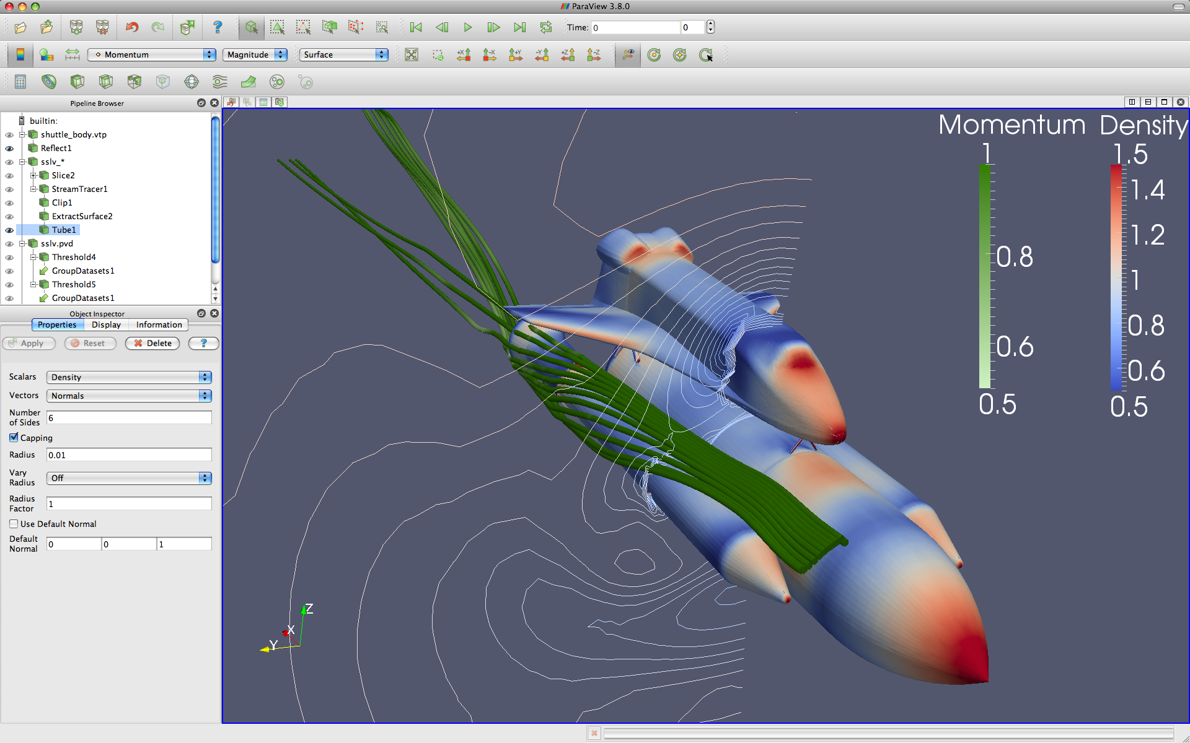



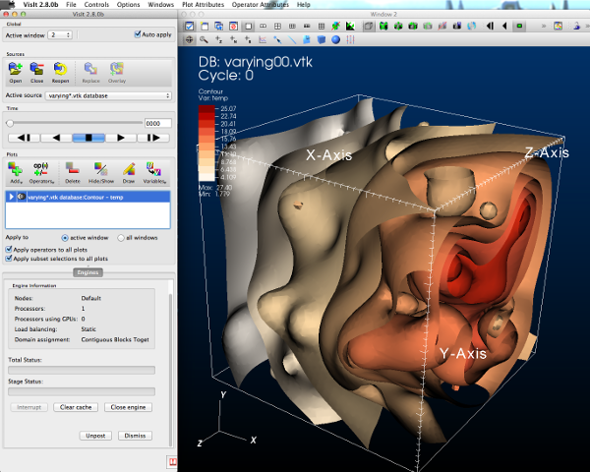


GUI / Parallel Management
Simulations
In Situ Vis Library
(Integration with Sim)
Base Vis Library
(Algorithm Implementation)
Libsim
Multithreaded Algorithms
Processor Portability
LA-UR16-21111
Notes:
The basic software stack for the XVis project

Slide 11
Applications Using VTK-m
Example Applications
LA-UR16-21111

Slide 12
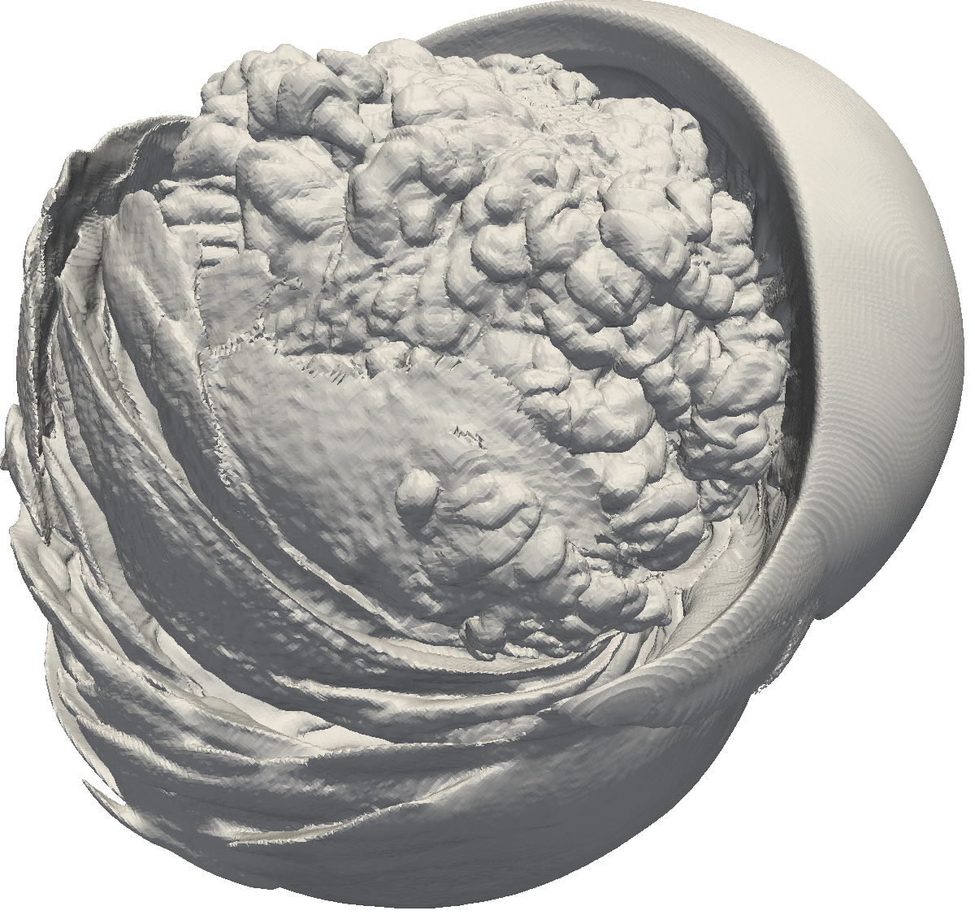
Isosurface
LA-UR16-21111

Slide 13
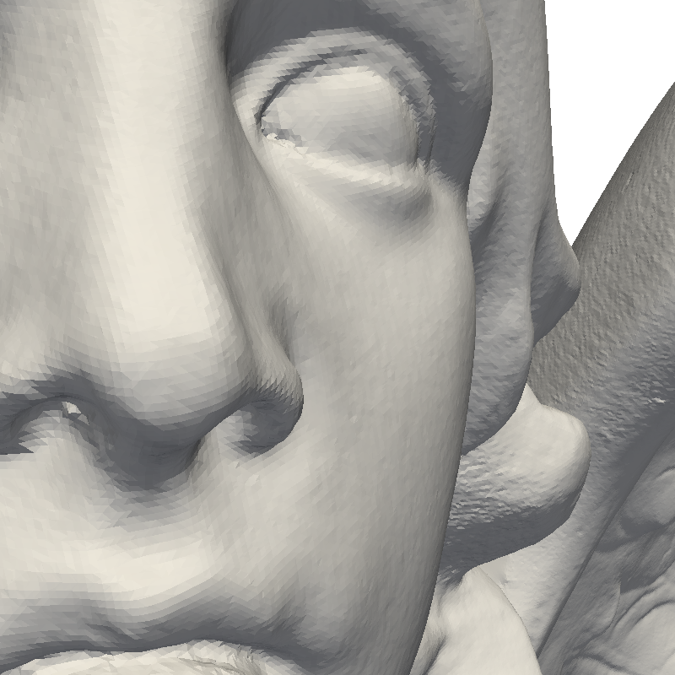
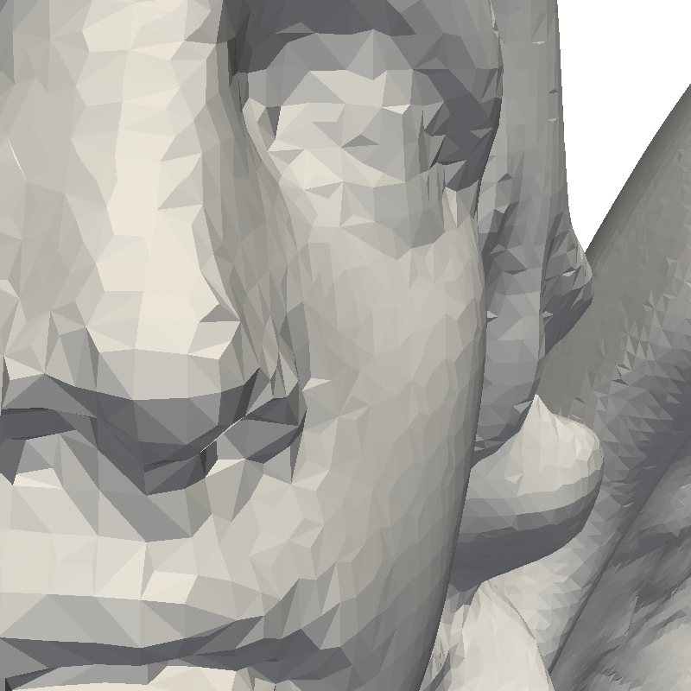
Surface Simplification
LA-UR16-21111

Slide 14

Ray Tracing
LA-UR16-21111

Slide 15
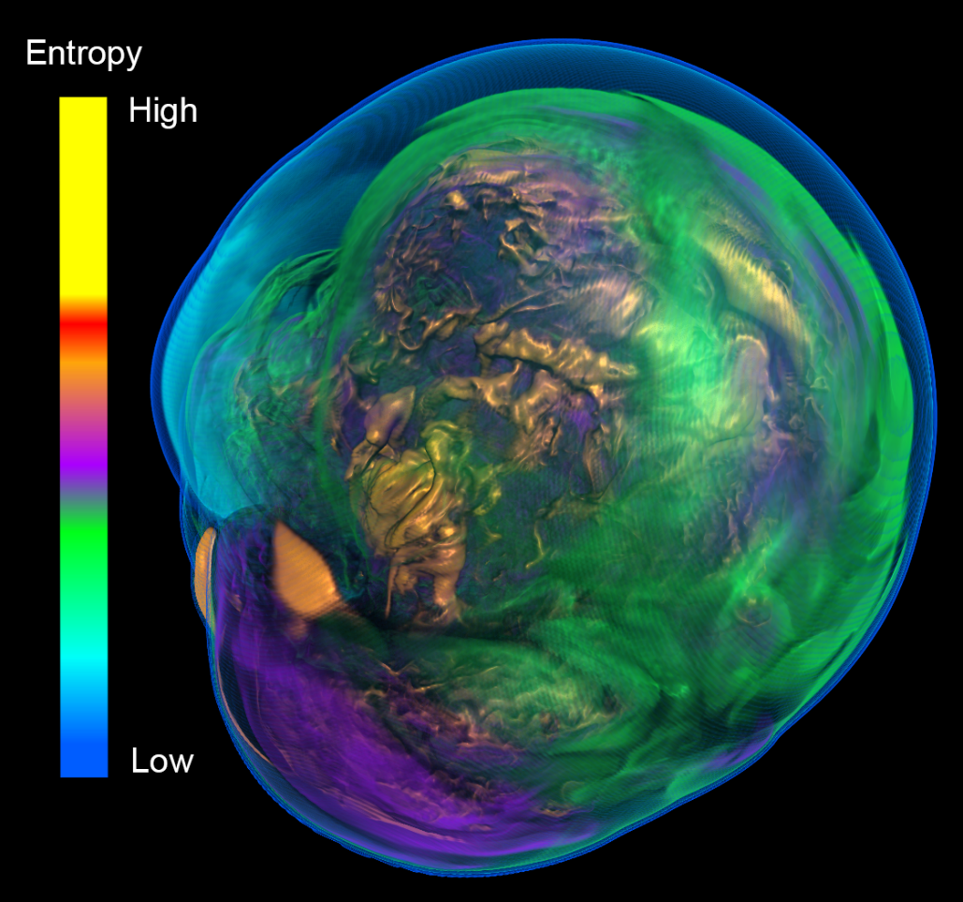
Direct Volume Rendering
LA-UR16-21111

Slide 16
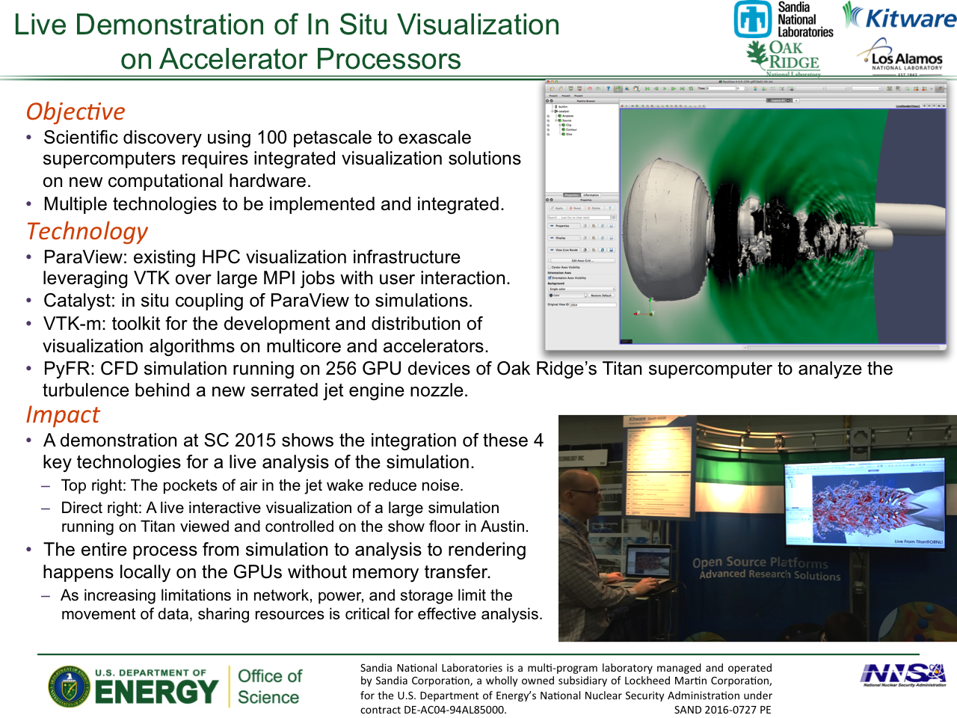
LA-UR16-21111

Slide 17
Data-Parallel Programming
Primitives and Algorithms
LA-UR16-21111

Slide 18
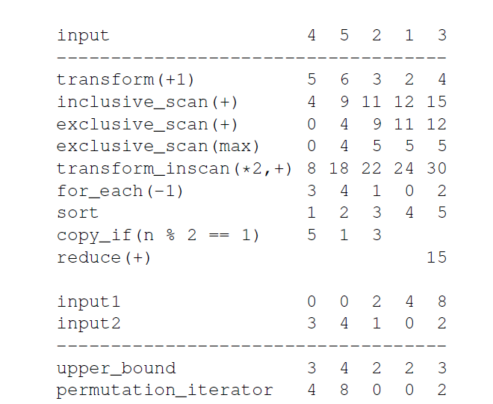
Brief Introduction to Data-Parallel Programming
Sorts
Transforms
Reductions
Scans
Binary searches
Stream compactions
Scatters / gathers
Data-parallel “primitives” that can be parallelized
Challenge: Write algorithms in terms of these primitives only
Reward: Efficient, portable code
LA-UR16-21111
LA-UR-13-23729

Slide 19
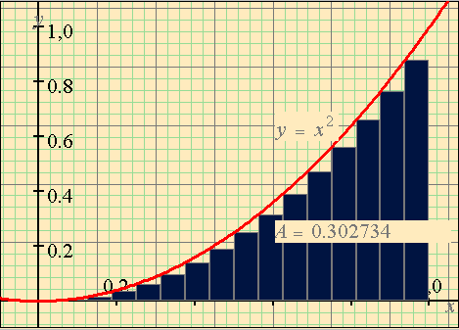
Simple Numerical Integration
thrust::device_vector<int> width(11, 0.1); width = 0.1 0.1 0.1 0.1 0.1 0.1 0.1 0.1 0.1 0.1 0.1 thrust::sequence(x.begin(), x.end(), 0.0f, 0.1f); x = 0.0 0.1 0.2 0.3 0.4 0.5 0.6 0.7 0.8 0.9 1.0 thrust::transform(x.begin(), x.end(), height.begin(), square()); height = 0.0 0.01 0.04 0.09 0.16 0.25 0.36 0.49 0.64 0.81 1.0 thrust::transform(width.begin(), width.end(), height.begin(), area.begin(), thrust::multiplies<float>()) area = 0.0 0.001 0.004 0.009 0.016 0.025 0.036 0.049 0.064 0.081 0.1 total_area = thrust::reduce(area.begin(), area.end()); total_area = 0.385
thrust::inclusive_scan(area.begin(), area.end(), accum_areas.begin()); accum_areas = 0.0 0.001 0.005 0.014 0.030 0.055 0.091 0.140 0.204 0.285 0.385
LA-UR16-21111

Slide 20
Isosurface with Marching Cubes – the Naive Way
Classify all cells by transform
Use copy_if to compact valid cells.
For each valid cell, generate same number of geometries with flags.
Use copy_if to do stream compaction on vertices.
This approach is too slow, more than 50% of time was spent moving huge amount of data in global memory.
Can we avoid calling copy_if and eliminate global memory movement?
LA-UR16-21111
LA-UR-13-23729

Slide 21
Isosurface with Marching Cubes – Optimization
Inspired by HistoPyramid
The filter is essentially a mapping from input cell id to output vertex id
Is there a “reverse” mapping?
If there is a reverse mapping, the filter can be very “lazy”
Given an output vertex id, we only apply operations on the cell that would generate the vertex
Actually for a range of output vertex ids
0
1
2
3
4
5
6
0
2
3
4
8
1
6
9
5
7
LA-UR16-21111
LA-UR-13-23729

Slide 22
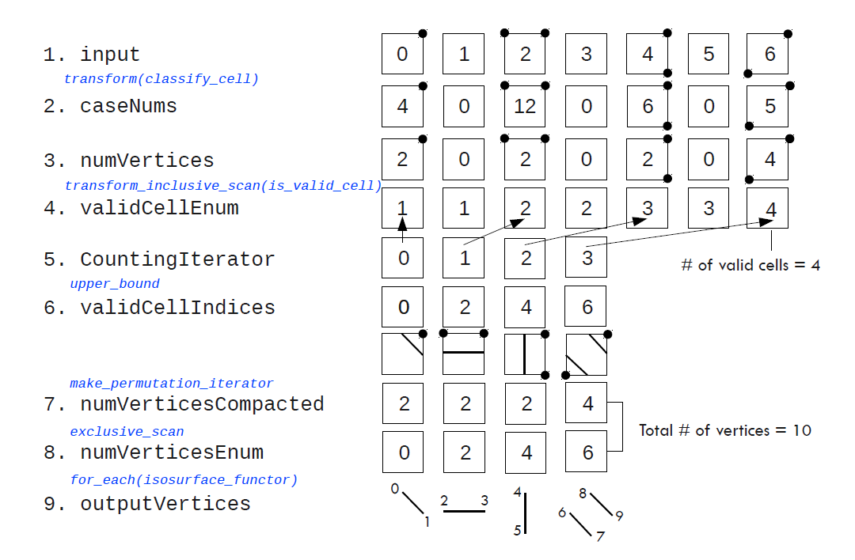
Isosurface with Marching Cubes Algorithm
LA-UR16-21111
LA-UR-13-23729

Slide 23
Variations on Isosurface: Cut Surfaces and Threshold
Cut surface
Two scalar fields, one for generating geometry (cut surface) the other for scalar interpolation
Less than 10 LOC change, negligible performance impact to isosurface
One 1D interpolation per triangle vertex
Threshold
Classify cells, this time based on whether value at each vertex falls within threshold range, then stream compact valid cells and generate geometry for valid cells
Additional pass of cell classification and stream compaction to remove interior cells
LA-UR16-21111
LA-UR-13-23729

Slide 24
Introductory Tutorial
How to get started using VTK-m
LA-UR16-21111

Slide 25
Prerequisites
Always required:
git
CMake (2.10 or newer)
Boost 1.48.0 (or newer)
Linux, Mac OS X, or MSVC
For CUDA backend:
CUDA Toolkit 7+
Thrust (comes with CUDA)
For Intel Threading Building Blocks backend:
TBB library
LA-UR16-21111

Slide 26
Getting, Building, and Running VTK-m
http://m.vtk.org → Building VTK-m
Clone from the git repository
https://gitlab.kitware.com/vtk/vtk-m.git
Run ccmake (or cmake-gui) pointing back to source directory
Run make (or use your favorite IDE)
Run tests (“make test” or “ctest”)
git clone http://gitlab.kitware.com/vtk/vtk-m.git
mkdir vtk-m-build
cd vtk-m-build
ccmake ../vtk-m
make
ctest
LA-UR16-21111

Slide 27
ArrayHandle
vtkm::cont::ArrayHandle<type> manages an “array” of data
Acts like a reference-counted smart pointer to an array
Manages transfer of data between control and execution
Can allocate data for output
Relevant methods
GetNumberOfValues()
GetPortalConstControl()
ReleaseResources(), ReleaseResourcesExecution()
Functions to create an ArrayHandle
vtkm::cont::make_ArrayHandle(const T*array,vtkm::Id size)
vtkm::cont::make_ArrayHandle(const std::vector<T>&vector)
Both of these do a shallow (reference) copy.
Do not let the original array be deleted or vector to go out of scope!
LA-UR16-21111

Slide 28
Array Handle Storage
Array Handle
Array of Structs Storage
x₀
y₀
z₀
x₁
y₁
z₁
x₂
y₂
z₂
x₀
y₀
z₀
x₁
y₁
z₁
x₂
y₂
z₂
Array Handle
x₀
x₁
x₂
Struct of Arrays Storage
y₀
y₁
y₂
x₀
y₀
z₀
x₁
y₁
z₁
x₂
y₂
z₂
z₀
z₁
z₂
Array Handle
vtkCellArray Storage
v₀
v₁
v₂
v₃
v₄
v₅
v₆
v₇
v₈
3
v₀
v₁
v₂
3
v₃
v₄
v₅
3
v₆
v₇
v₈
LA-UR16-21111

Slide 29
Fancy Array Handles
Array Handle
Constant Storage
c
c
c
c
c
c
c
c
c
c
Array Handle
Uniform Point Coord Storage
f(i,j,k) = [o_{x} + s_{x} i, o_{y} + s_{y} j, o_{z} + s_{z} k]
x₀
y₀
z₀
x₁
y₁
z₁
x₂
y₂
z₂
Array Handle
8
5
5
0
5
2
0
3
5
Array Handle
Permutation Storage
x₈
x₅
x₅
x₀
x₅
x₂
x₀
x₃
x₅
Array Handle
x₀
x₁
x₂
x₃
x₄
x₅
x₆
x₇
x₈
LA-UR16-21111

Slide 30
DynamicArrayHandle
DynamicArrayHandle is a magic untyped reference to an ArrayHandle
Statically holds a list of potential types and storages the contained array might have
Can be changed with ResetTypeList and ResetStorageList
Changing these lists requires creating a new object
Parts of VTK-m will automatically staticly cast a DynamicArrayHandle as necessary
Requires the actual type to be in the list of potential types
LA-UR16-21111

Slide 31
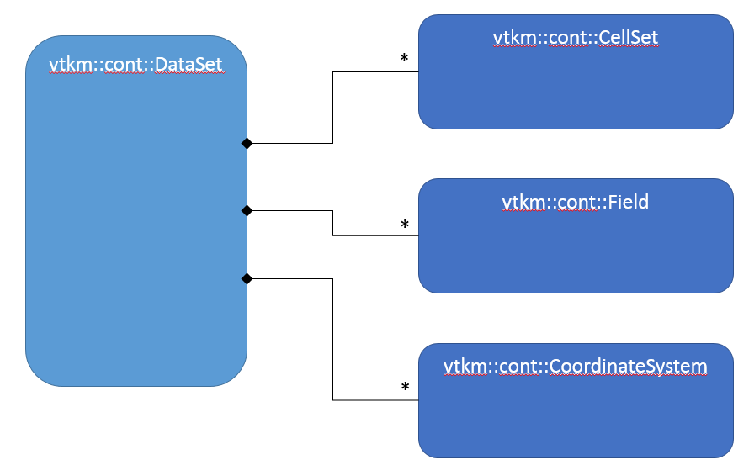
A DataSet Has
1 or more CellSet
Defines the connectivity of the cells
Examples include a regular grid of cells or explicit connection indices
0 or more Field
Holds an ArrayHandle containing field values
Field also has metadata such as the name, the topology association (point, cell, face, etc), and which cell set the field is attached to
0 or more CoordinateSystem
Really just a Field with a special meaning
Contains helpful features specific to common coordinate systems
LA-UR16-21111

Slide 32
Worklet Types
WorkletMapField: Applies worklet on each value in an array.
WorkletMapTopology: Takes from and to topology elements (e.g. point to cell or cell to point). Applies worklet on each “to” element. Worklet can access field data from both “from” and “to” elements. Can output to “to” elements.
Many more to come…
LA-UR16-21111

Slide 33
struct Sine: public vtkm::worklet::WorkletMapField {
typedef void ControlSignature(FieldIn<>, FieldOut<>);
typedef _2 ExecutionSignature(_1);
template<typename T>
VTKM_EXEC_EXPORT
T operator()(T x) const {
return vtkm::Sin(x);
}
};
Execution Environment
Control Environment
vtkm::cont::ArrayHandle<vtkm::Float32> inputHandle =
vtkm::cont::make_ArrayHandle(input);
vtkm::cont::ArrayHandle<vtkm::Float32> sineResult;
vtkm::worklet::DispatcherMapField<Sine> dispatcher;
dispatcher.Invoke(inputHandle, sineResult);
LA-UR16-21111

Slide 34
Elements of a Worklet
Subclass of one of the base worklet types
Typedefs for ControlSignature and ExecutionSignature
A parenthesis operator
Must have VTKM_EXEC_EXPORT
Input parameters are by value or const reference
Output parameters are by reference
The method must be declared const
1
struct ImagToPolar: public vtkm::worklet::WorkletMapField {
typedef void ControlSignature(FieldIn<vtkm::TypeListTagScalar>,
FieldIn<vtkm::TypeListTagScalar>,
FieldOut<vtkm::TypeListTagScalar>,
FieldOut<vtkm::TypeListTagScalar>);
typedef void ExecutionSignature(_1, _2, _3, _4);
template<typename T1, typename T2, typename T3, typename T4>
VTKM_EXEC_EXPORT
void operator()(T1 real, T2 imaginary,
T3 &magnitude, T4 &phase) const {
2
3.1
3.2
3.4
3.3
LA-UR16-21111

Slide 35
Cell Shapes
VTK-m cell shapes copy those of VTK
Basic shapes defined in vtkm/CellShape.h
Every cell shape has an enum identifier
e.g. vtkm::CELL_SHAPE_TRIANGLE, vtkm::CELL_SHAPE_HEXAHEDRON
Every cell shape has a tag struct
e.g. vtkm::CellShapeTagTriangle, vtkm::CellShapeTagHexahedron
All cell shape tags have a member Id set to the identifier
vtkm::CellShapeTagTriangle::Id == vtkm::CELL_SHAPE_TRIANGLE
For a constant cell shape identifier, can get tag with vtkm::CellShapeIdToTag
vtkm::CellShapeIdToTag<CELL_SHAPE_TRIANGLE>::Tag is typedef’ed to vtkm::CellShapeTagTriangle
LA-UR16-21111

Slide 36
Using Cell Shapes in Worklets
Use the ExecutionSignature tag CellShape
Defined in worklet types that support it (e.g. WorkletMapTopology)
struct MyWorklet : public vtkm::worklet::WorkletMapTopology<vtkm::TopologyElementTagPoint,
vtkm::TopologyElementTagCell>
{
typedef void ControlSignature(TopologyIn topology,
FieldInFrom<Scalar> inField,
FieldOut<Scalar> outCells)
typedef _3 ExecutionSignature(CellShape, _2);
template<typename CellShapeTag, typename InValues>
VTKM_EXEC_EXPORT
T operator()(CellShapeTag shape, const InValues &inValues) const
{
// Operate using shape...
LA-UR16-21111

Slide 37
Cell Operations
#include <vtkm/exec/ParametricCoordinates.h>
Convert between world coordinates and parametric coordinates (locations in the cell are always in the range [0,1])
#include <vtkm/exec/CellInterpolate.h>
Given a group of field coordinates and a parametric coordinate, interpolates the field to that point.
#include <vtkm/exec/CellDerivative.h>
Given a group of field coordinates and a parametric coordinate, computes the derivative (gradient) of the field at that point.
LA-UR16-21111

Slide 38
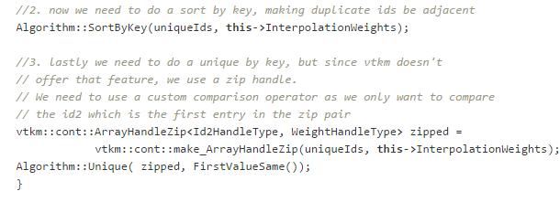
Device Adapter Algorithms
Implementations of data-parallel primitives
Copy
LowerBounds
Reduce
ReduceByKey
ScanInclusive
ScanExclusive
Sort
SortByKey
StreamCompact
Unique
UpperBounds
LA-UR16-21111

Slide 39
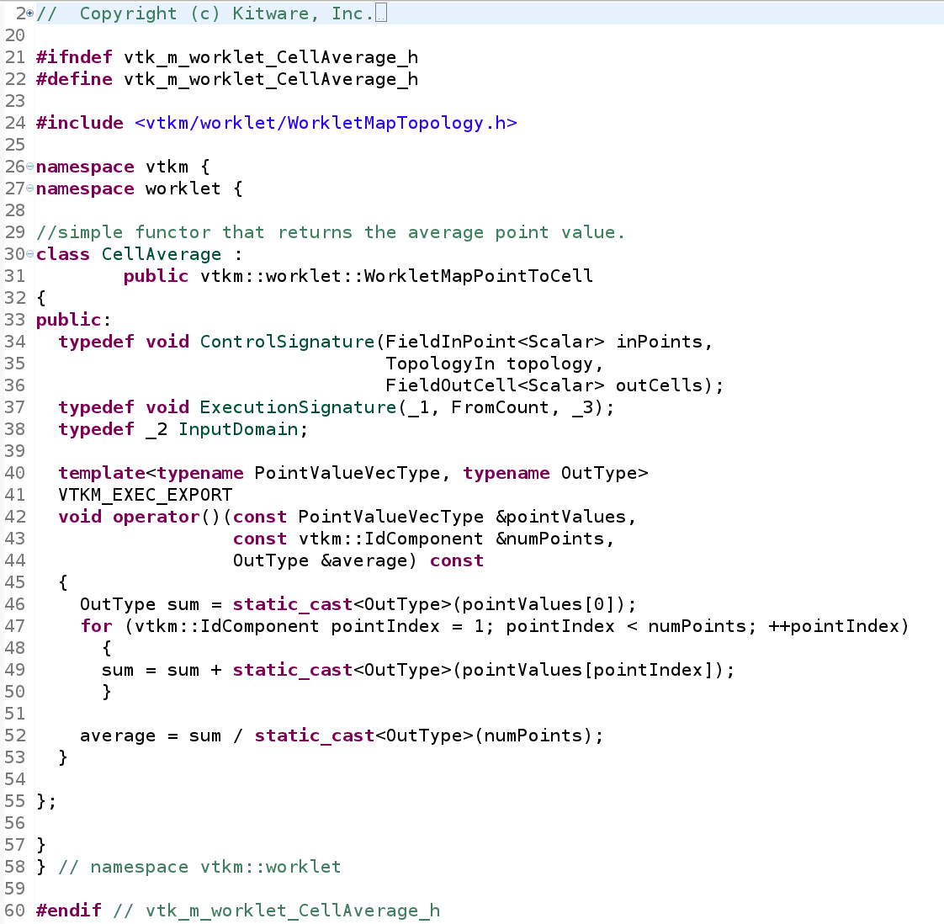
Worklet Example: Cell Average
LA-UR16-21111

Slide 40
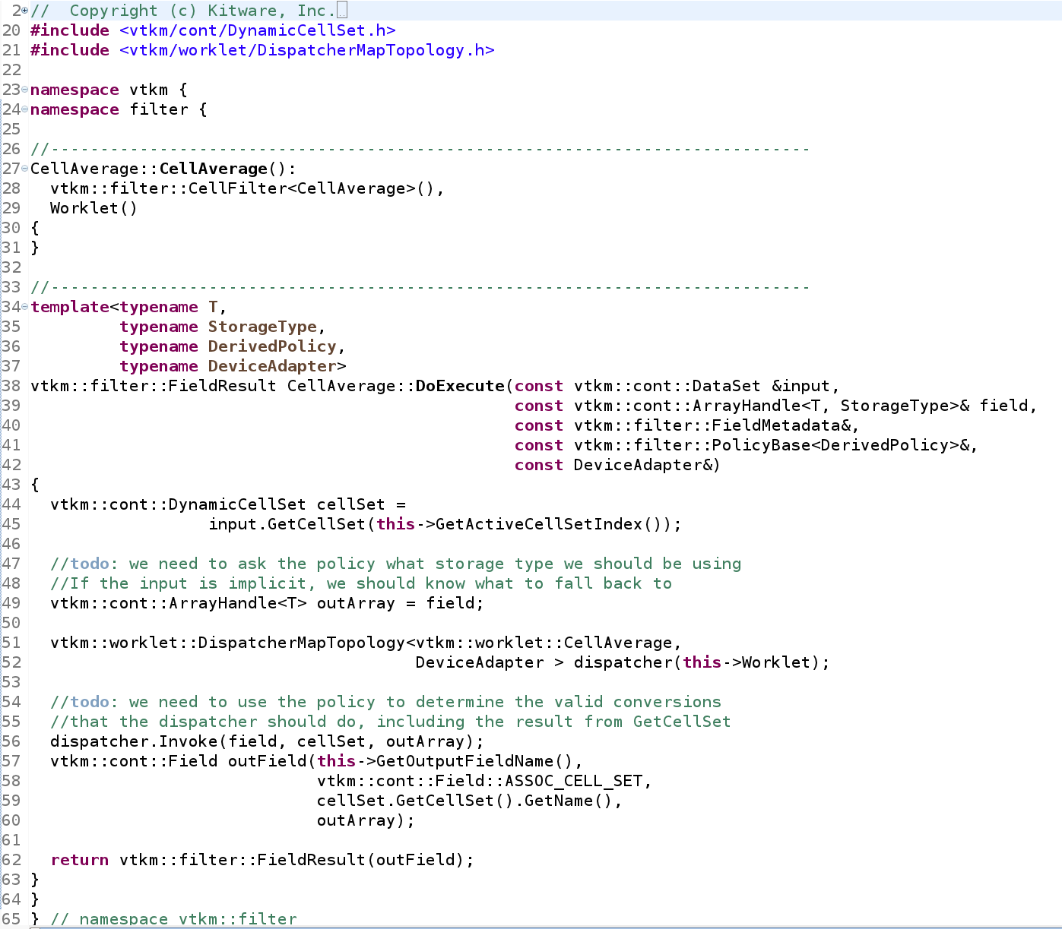
Filter Example: Cell Average
LA-UR16-21111

Slide 41
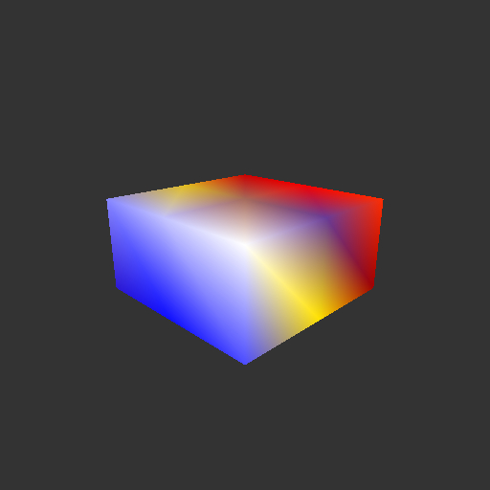
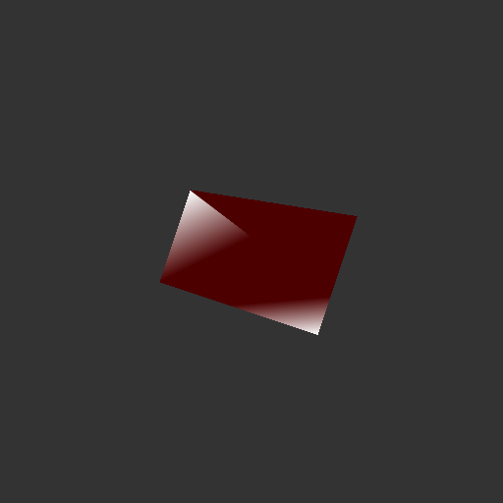
Demo
In vtk-m/examples/demo
Reads specified VTK file or generates a default input uniform structured grid data set
Uses VTK-m’s rendering engine to render input data set to an image file using OS Mesa (or EGL, in development)
Uses VTK-m’s Marching Cubes filter to compute isosurface
Renders output data set to another image file
Rendering of test input data
Rendering of test output data
LA-UR16-21111

Slide 42
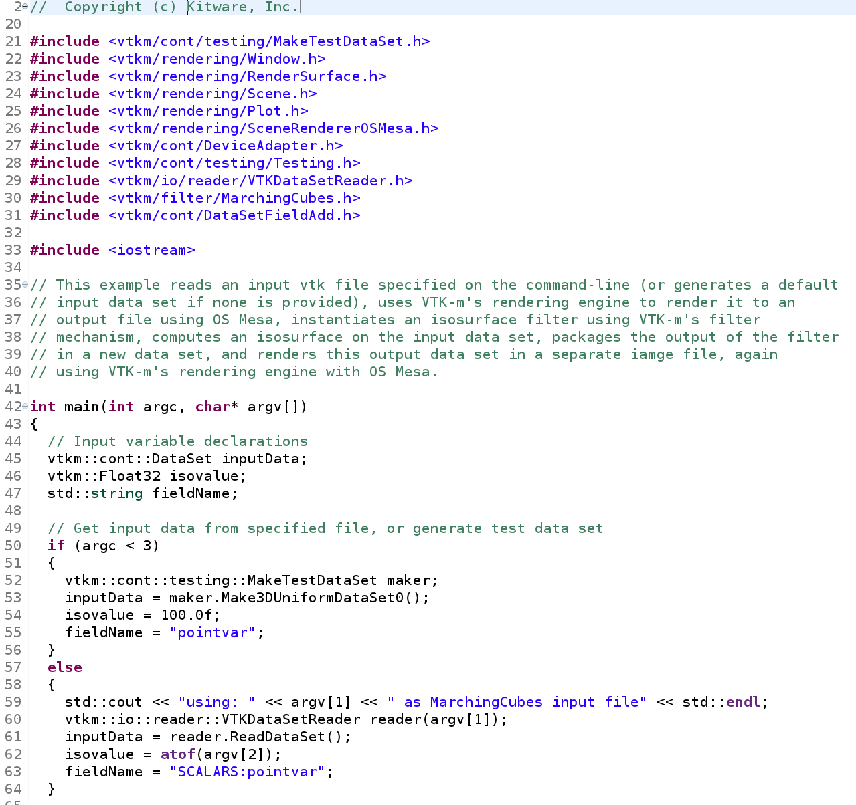
Demo Part 1: Reading Input
LA-UR16-21111

Slide 43
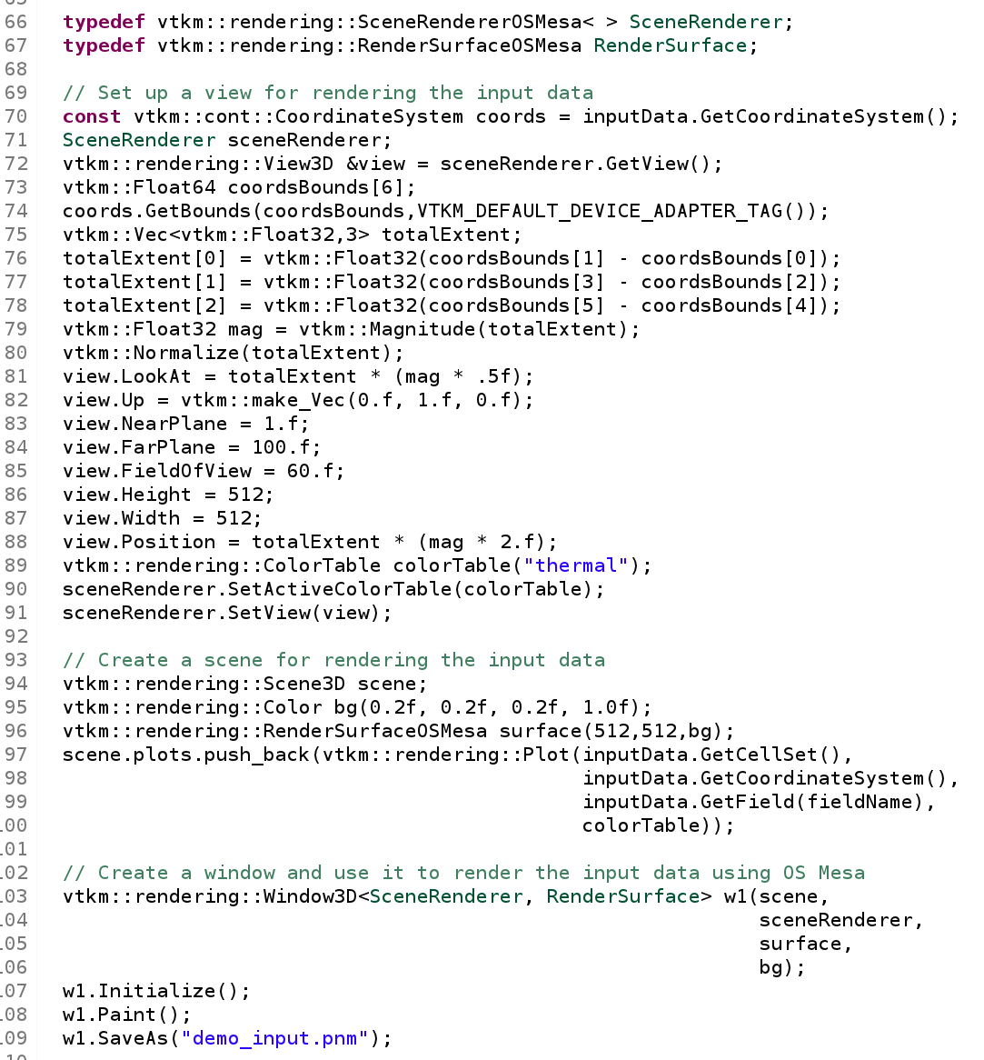
Demo Part 2: Rendering Data Set
LA-UR16-21111

Slide 44
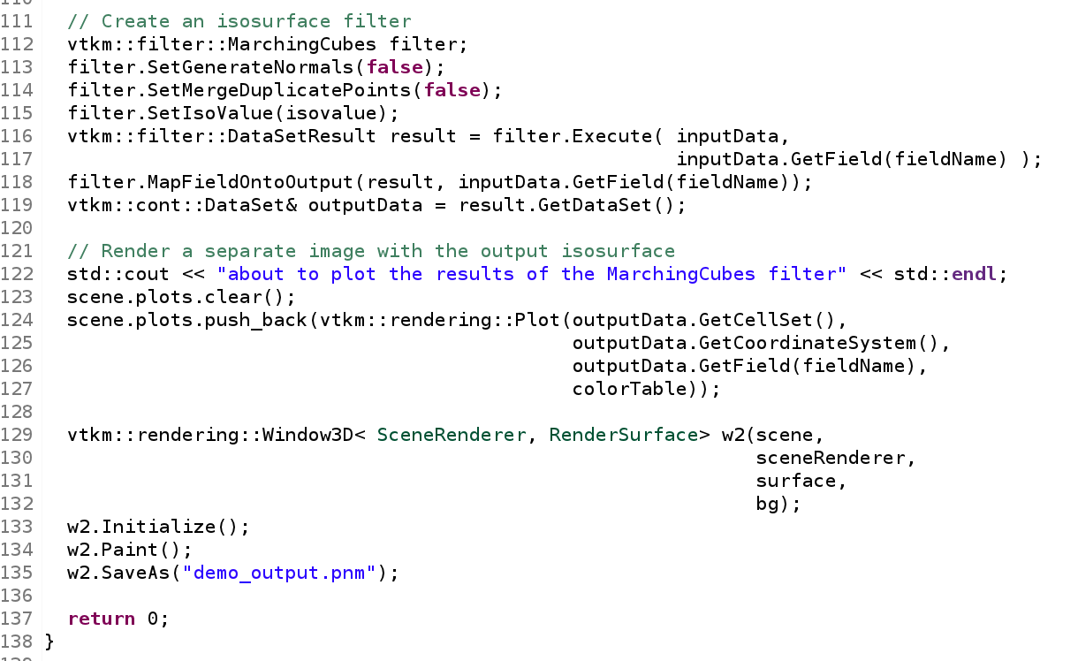
Demo Part 3: Marching Cubes Filter
LA-UR16-21111

Slide 45
Acknowledgements
This material is based upon work supported by the U.S. Department of Energy, Office of Science, Office of Advanced Scientic Computing Research,under Award Numbers 14-017566 and 12-015215.
SDAV: The Scalable Data Management, Analysis, and Visualization SciDAC Institute
XVis: Visualization for the Extreme-Scale Scientific-Computation Ecosystem
LA-UR16-21111

